Slide 1

Foundational components of Microsoft Azure Stack Hub
Azure Stack Hub Identity
This work is licensed under a Creative Commons Attribution - ShareAlike 4.0 International Public License

Slide 2
Agenda
Identity Terminology and Background
Azure Identity model
Azure Stack Hub Identity fundamentals
Directory-Based Authentication
Azure Active Directory
Single-tenanted topology
Multi-tenanted topology
Active Directory Federation Services

Slide 3
Identity Terminology and Background

Slide 4


Directory tenants
->
Tenants are Organizations
Users
Service Principals
Applications

Slide 5
Users
invited to
Guest user
Home Directory Tenant
Guest Directory Tenant

Slide 6
Applications
Home Directory Tenant
Other Directory Tenants

Slide 7


Service Principals (SP)
Home Directory Tenant
Other Directory Tenants

Slide 8
Use app identity to access resources
Authentication Elements
An Application ID, sometimes referred to as a Client ID.
GUID that uniquely identifies the app's registration in your AD tenant.
A secret associated with the application ID.
Can generate a client secret string (similar to a password), or specify an X509 certificate (which uses its public key).
Why use this?
Stronger credentials
app can sign in using an X509 certificate, versus textual shared secret/password.
More restrictive permissions can be assigned to an app.
Credentials and permissions don't change as frequently for an app as user credentials.
Use Cases
Connected
Disconnected
Use an app identity to access resources - Azure Stack Hub | Microsoft Docs

Slide 9
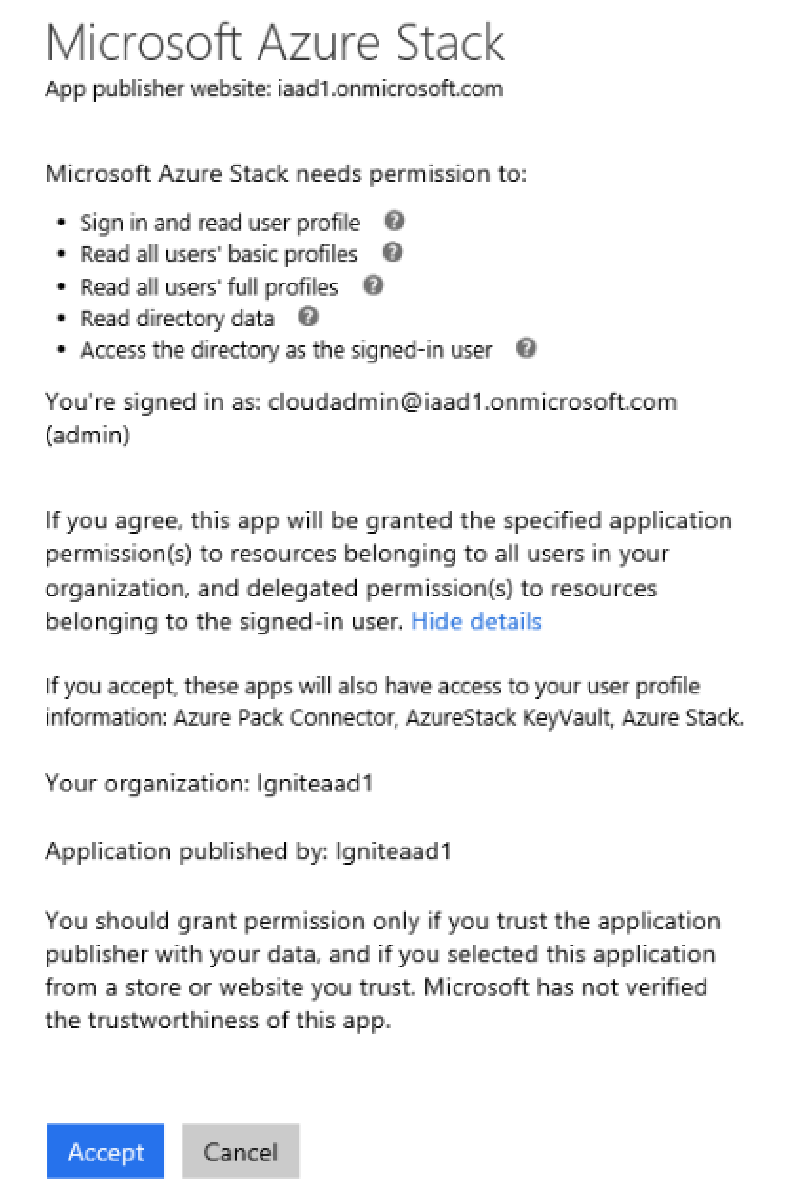
Consent to applications
Consent is of two basic kinds
User-level consent – applicable only to the current user
Admin-level consent – applicable to the entire directory
Azure Stack Hub has been configured to require an Administrator’s consent when connecting to a directory
Because we need permissions to be able to read directory data

Slide 10
Protocols
OAuth 2.0
Authorizes access to Web Applications and WebAPIs
Registering the application gives Application ID and enables it to receive
Read more
OpenID Connect*
Simple identity layer built on top of the OAuth 2.0 protocol
Defines mechanisms to obtain and use access tokens to access protected resources
Implements authentication as an extension to the OAuth 2.0 authorization process
Format is JSON Read more
SAML 2.0
Azure AD uses the SAML 2.0 protocol to provide SSO Experience
SAML profiles of Azure AD explain how assertions, protocols and bindings are used
Read more
*Azure Stack Hub uses only OpenID connect protocol

Slide 11
Token types
Access tokens
Used to access protected resources
Used for a specific combination of user, client, and resource
Cannot be revoked and valid until expire
Refresh tokens
When resource is accessed, client receives refresh and access token
Refresh token used to access a new access token when one expires
Can be revoked
ID tokens
Contain profile information about a user. Valid until Expire. Represented as JSON Web Tokens – they contain claims
Session tokens (SSO)
Cookie used for Keep-me-Singed-In (kmsi). Can be revoked
Persistent and non-persistent

Slide 12

Azure Active Directory (AAD) Architecture
Azure Active Directory
Invited to
Guest user of
User@dt1
.onmicrosoft.com
User@dt1
(Guest)
Service Principal for Application1 in dt2
Service Principal
Application1
dt1.onmicrosoft.com
dt2…(N).onmicrosoft.com

Slide 13
AD FS architecture
AD FS is single-tenanted
Represents a single organization
Users are created in AD
Applications are created in ADFS
Service Principals are a combo
Application in AD FS + “User” in AD
Active Directory
Federation Services
User
@contosocom
Service Principal
Application1
contoso.com

Slide 14
Azure Identity Model

Slide 15
Azure (Stack) Identity at different layers
Portal
Tools
JSON Web Token
Azure Resource Manager
Certificate-based authentication
Resource Providers
Resource Provider’s choice of authentication
Business Logic/Infrastructure

Slide 16

Portal authentication flow
2
3
ID Token
Authorization Code
/ AD FS
ID Token
1
Authorization Code
5
Authorization Code
4
6
Access Token
Refresh Token
ID Token
Access Token
7
Resource Manager
Portal

Slide 17
Portal Login with Multiple Azure AD tenants

Slide 18
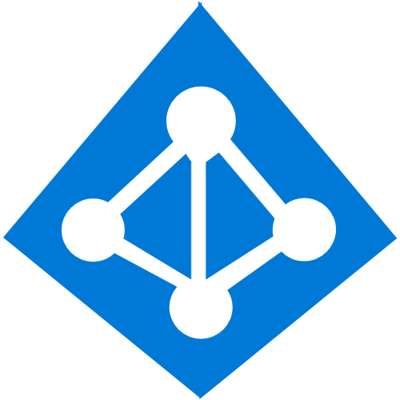
Without any particular tenant identifier
Common
https://login.windows.net/common
joe@contoso.onmicrosoft.com
Contoso
https://login.windows.net/contoso.onmicrosoft.com
Portal
https://portal.azure.com
Iss:
https://login.windows.net/<contoso.onmicrosoft.com GUID>
Aud:
<ARM Resource Identifier>
Token

Slide 19
With a particular tenant identifier
Contoso
https://login.windows.net/fabrikam.onmicrosoft.com
joe@contoso.onmicrosoft.com
Portal
Iss:
https://login.windows.net/<fabrikam.onmicrosoft.com GUID>
Aud:
<ARM Resource Identifier>
https://Portal.azure.com/fabrikam.onmicrosoft.com
Token

Slide 20

The bottom line
You always login to the Portal/API in the context of a particular directory
If you are a Guest to a directory, you can specify that directory when you login

Slide 21
Azure Stack Hub Identity Fundamentals

Slide 22
Azure Stack Hub identity fundamentals
Decision needs to be made before deployment
Two possible options for identity provider
Azure Active Directory
ADFS
Changing identity provider after deployment is not possible
To change identity provider you need to re-deploy Azure Stack Hub
OpenID Connect Protocol
Authorization Code Flow
Resource Owner flow
Utilizes JSON Web Tokens (JWT)
Use Azure tools to manage Azure and Azure Stack Hub
Use ADAL libraries to authenticate

Slide 23
Azure Stack Hub identity fundamentals
Capabilities and limitations
Capability or scenario | Azure AD | AD FS
Connected to the internet | Yes | Optional
Support for multi-tenancy | Yes | No
Offer items in the Marketplace | Yes | Yes. Requires use of the offline Marketplace syndication tool.
Support for Active Directory Authentication Library (ADAL & MSAL) | Yes | Yes
Support for tools such as Azure CLI, Visual Studio, and PowerShell | Yes | Yes
Create service principals through the Azure portal | Yes | No
Create service principals with certificates | Yes | Yes
Create service principals with secrets (keys) | Yes | Yes
Applications can use the Graph service | Yes | No
Applications can use identity provider for sign-in | Yes | Yes. Requires applications to federate with on-premises AD FS instances.

Slide 24
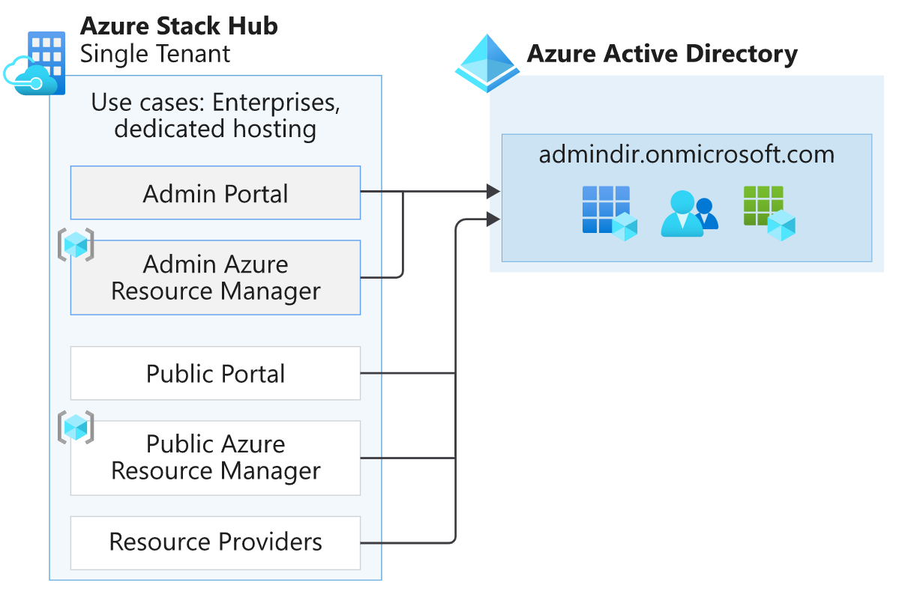
Azure Stack Hub with AAD – Single-tenanted
Use cases: Enterprises, Dedicated Hosting

Slide 25
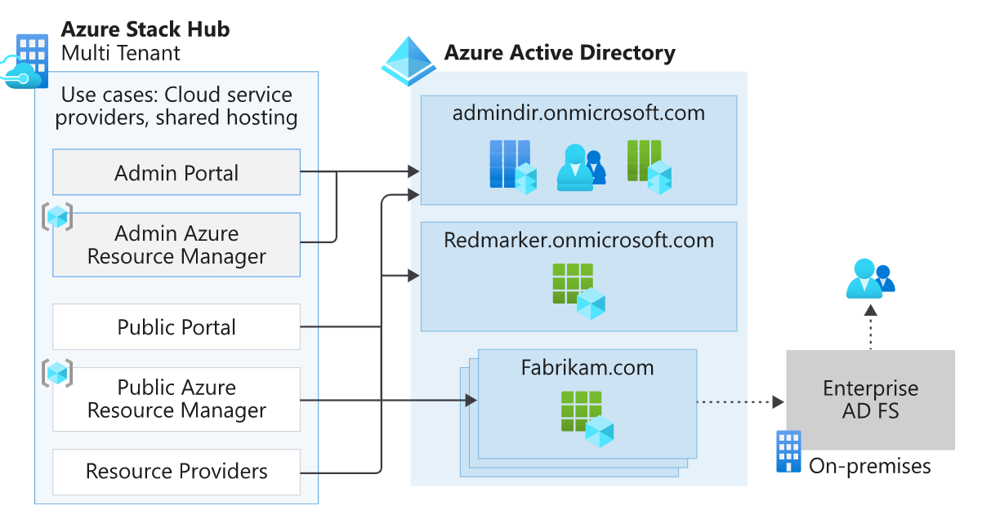
Azure Stack Hub with AAD – Multi-tenanted
Use cases: CSP, Shared Hosting

Slide 26
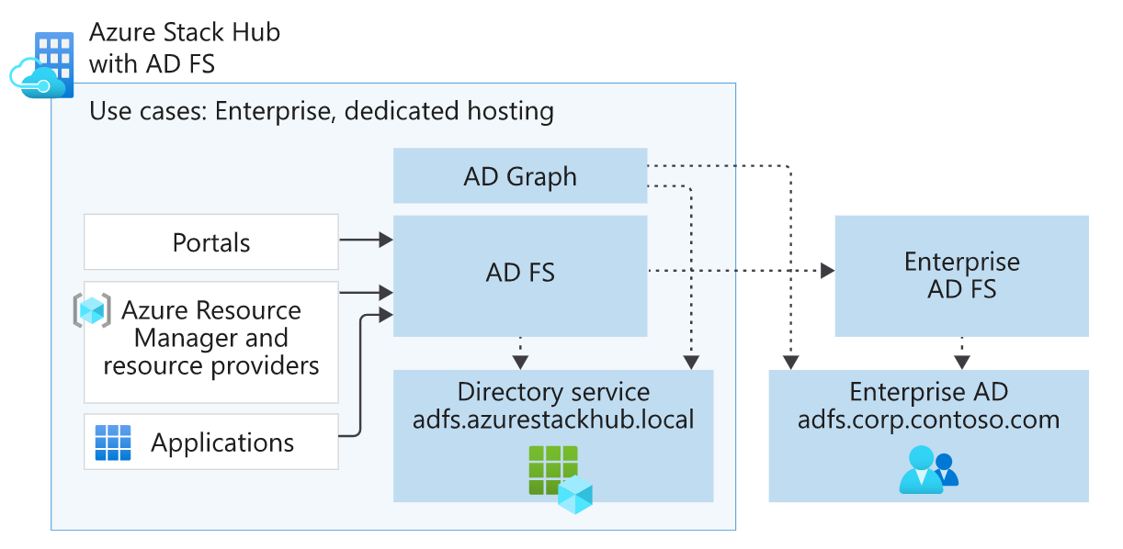
Azure Stack Hub with AD FS
Use cases: Disconnected Scenario, Use AD FS
Identity architecture for Azure Stack Hub - Azure Stack Hub | Microsoft Docs

Slide 27
AD Graph
AD-based
ODATA Web Service – supports CRUD and query operations against AD and ADFS
Support only the subset of APIs needed by Azure Stack Hub
Same contracts as the AAD Graph (for supported APIs)
Co-located with AD FS
Facilitates interaction with Azure Stack Hub fabric AD DS and customer directory
LDAP protocol is used for querying Customers Directory
AD FS operations are performed via PowerShell cmdlets

Slide 28
Azure Resource Manager Role-Based Access Control (RBAC)

Slide 29
Role-based access control
Allows secure access with granular permissions
Assignable to users, groups, or service principals
3 Built-in roles make it easy to get started
Owner
Contributor
Reader
Custom Roles
Consistent with Microsoft Azure
People-picker experience integrated into the portal UX
Scope to Subscription, Resource Group or per Azure Resource

Slide 30
Role-based access control

Slide 31
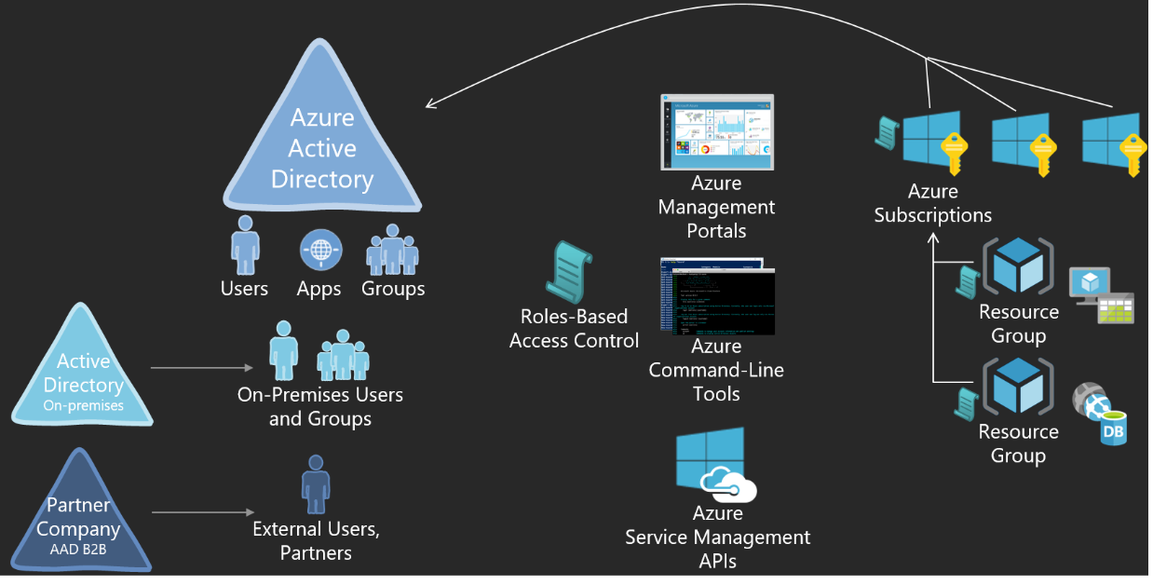
Role-based access control
Used only for Azure administration
Manage resources in Azure – i.e. Virtual Machines, storage, networks, etc.
Remember that Azure AD is not an Azure resource
Roles composed of:
Actions
Not Actions (excluded operations)
Scopes

Slide 32
Two key concepts
Role definitions
Describes the set of permissions (e.g. read actions)
Can be used in multiple assignments
Role assignments
Associate role definitions with an identity (e.g. user/group) at a scope (e.g. resource group)
Always inherited – subscription assignments apply to all resources

Slide 33
Built-in roles
Built-in role | Actions | Not Actions
Owner (allow all actions) | *
Contributor (allow all actions except writing or deleting role assignments) | * | Microsoft.Authorization/*/Write, Microsoft.Authorization/*/Delete
Reader (allow all read actions) | */Read
Custom roles can be created using RBAC command-line tools in Azure PowerShell, and Azure Command-Line Interface

Slide 34
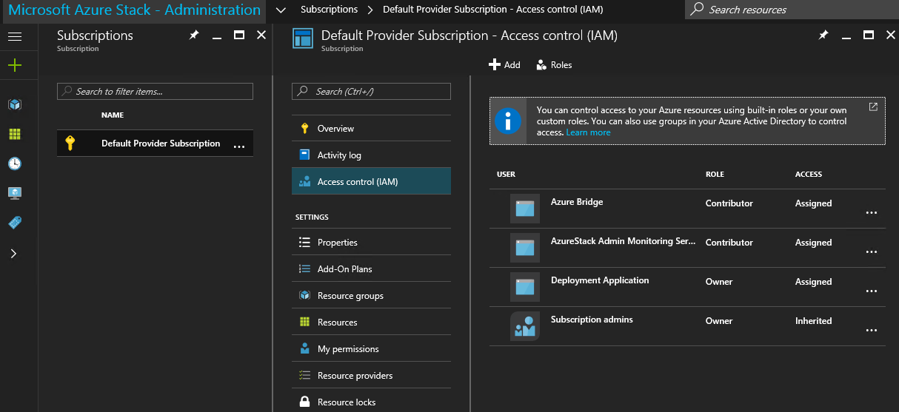
Least privilege
Goal
Users can do the tasks their job requires
But no more than that
Best practices
Use the portal or ARM API
Assign the right role
Use resource groups to form collections of multiple resources that require RBAC permissions

Slide 35
Custom roles - configuration
Get-AzureRmRoleDefinition command to output the base role in JSON format
Open the OutputRole.json file in an editor
Edit the JSON file
New-AzureRmRoleDefinition command and specify the JSON role definition file.
Assign role to the user

Slide 36
Custom roles – Example of JSON file
{
"Name": "AZS_test",
"Id": "7c5f3479-1f1b-433c-8256-72e803023d0b",
"IsCustom": true,
"Description": "AZS registration",
"Actions": [
"Microsoft.AzureStack/registrations/*"
],
"NotActions": [ ],
"DataActions": [ ],
"NotDataActions": [ ],
"AssignableScopes": [
"/subscriptions/da58hhhhhhhhhhhfa55efc"
]
}

Slide 37
Multi-Tenancy

Slide 38
Azure Stack Hub multi-tenancy
Azure Stack Hub can support users from multiple Azure Active Directory environments
One tenant subscription = One Azure Active Directory
Requires coordination between Azure Stack Hub operator and admin of tenant Azure Active Directory

Slide 39
One directory
Best practices
Organize resources to meet access management requirements
Grant access at resource group when appropriate
Benefits
Manageability
Compliance
Litware
Azure AD
Marketing Subscription
Resource Group 1
Resource
Resource
Resource Group 2
Resource
Resource
Finance Subscription
Resource Group A
Resource
Resource

Slide 40
Multiple directories
Usage
CSPs environment
Each customer use their AAD
One subscription can have resources only from one AAD
Litware
Azure AD
Subscription 01
Resource Group 1
Resource
Resource
Contoso
Azure AD
Resource Group 2
Resource
Resource
Subscription 02
Resource Group A
Resource
Resource

Slide 41
Azure Stack Hub multi-tenancy
Enable multi-tenancy
Configure Azure Stack Hub directory
Configure Azure Stack Hub to allow sign-ins from Fabrikam Azure AD directory tenants.
https://docs.microsoft.com/en-us/azure/azure-stack/azure-stack-enable-multitenancy#configure-azure-stack-directory
Configure guest directory
Registering Azure Stack Hub with the guest directory
https://docs.microsoft.com/en-us/azure/azure-stack/azure-stack-enable-multitenancy#registering-azure-stack-with-the-guest-directory

Slide 42

Azure Stack Hub multi-tenancy - Important
If Azure Stack Hub administrator installs new services or updates in the future, customer may need to run the multi-tenancy enabling script again
Run this script again at any time to check the status of the Azure Stack Hub multi-tenancy configuration applications in your directory.

Slide 43
Questions?

